Slide 1

Energy Consumption Analysis
A Relational Database Approach to Global Energy, Economic & Emission Insights
Dippu Sai Dinesh
Batch - 484

Slide 2
About me (Both Team Leader and Team Member)
I am a recent MBA graduate.
I want to be a Data Analyst because I like working with data to solve business problems and support smarter decision-making. My MBA and operations experience helped me understand the importance of data-driven insights.
LinkedIn : https://www.linkedin.com/publicprofile/settings?trk=d_flagship3_profile_self_view_public_profile
•Github :

Slide 3
AGENDA
Business Problem
ER Diagram
01
04
Global sustainability challenge
ENERGYDB relational schema
Problem Statement
SQL Queries & Analysis
02
05
Fragmented data & analytical gap
Trends, ratios, comparisons
Objectives
Conclusion & Recommendations
03
06
Database architecture & analytics goals
Policy & strategic insights

Slide 4

BUSINESS PROBLEM
01
73%
2x
195
of global CO₂ emissions
energy demand expected
nations generating
linked to energy use
to double by 2050
fragmented data
The Challenge
As the world accelerates toward sustainable development and climate change mitigation, governments and researchers face a critical gap: the data required to make informed policy decisions — national GDP, energy production, carbon emissions, and population — exists in silos. Without a unified analytical framework, patterns remain invisible and opportunities for intervention are missed.

Slide 5
PROBLEM STATEMENT
02
As the global focus shifts toward sustainable development and climate change mitigation, understanding the complex interplay between a nation's economic growth, population dynamics, and energy consumption is more critical than ever. However, raw data concerning national GDP, energy production, and carbon emissions is often fragmented and difficult to synthesize.
Without a centralized, relational data architecture, researchers and policymakers struggle to identify historical trends, assess the true per-capita environmental impact of growing populations, or determine whether economic growth is successfully decoupling from carbon emissions. There is a pressing need for a structured analytical framework to transform this fragmented macroeconomic and environmental data into actionable global insights.
Fragmented, siloed datasets across nations & years
No per-capita or GDP-relative emission benchmarks
Economic growth & carbon decoupling unmeasured

Slide 6




PROJECT OBJECTIVES
03
Architect a robust relational database (ENERGYDB) to integrate & analyze global energy, economic, and demographic data — uncovering trends in sustainability and resource consumption.
Relational Data Architecture
Environmental Impact Analysis
Fully normalized MySQL schema integrating country, emission, population, production, consumption & GDP tables with referential integrity.
Advanced SQL with CTEs & Window Functions (LAG, OVER) to compute per-capita emissions & decade-over-decade reduction trends.
Macroeconomic Correlation
Data-Driven Policy Insights
Evaluate relationships between GDP, population growth & energy demand; identify nations driving the most significant environmental impact.
Aggregate historical trends (avg. GDP, emissions & population by year) exportable to BI tools for executive dashboarding & strategic forecasting.

Slide 7
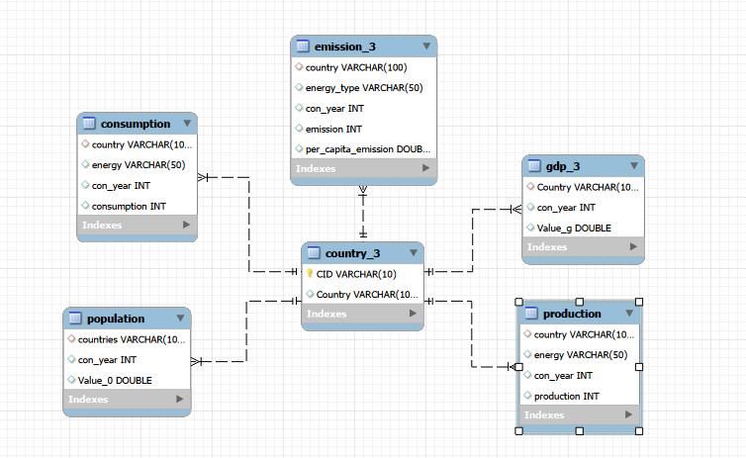
ER DIAGRAM — ENERGYDB SCHEMA

Slide 8
SQL QUERIES — ALL ANALYSIS CATEGORIES
05
General & Comparative
Trend Analysis Over Time
Total emissions per country (latest year)
Global emissions year-over-year (LAG window fn)
Top 5 countries by GDP
GDP trend per country over years
Energy production vs consumption (net energy)
Population growth vs. total emissions
Energy types contributing most to emissions
Energy consumption change — CTE + LAG
Ratio & Per Capita
Global Comparisons
Emission-to-GDP ratio by country & year
Top 10 countries by population vs emissions
Energy consumption per capita (last decade)
Countries with most improved per-capita emissions
Energy production per capita across countries
Global share (%) of emissions by country
Energy-to-GDP ratio (highest countries)
Global avg. GDP, emission & population by year
GDP vs. energy production growth correlation

Slide 9
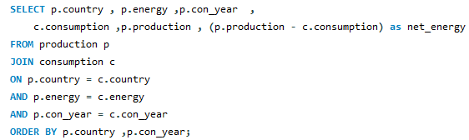
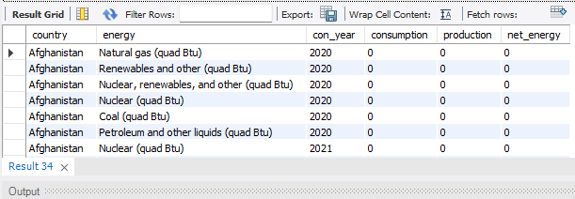
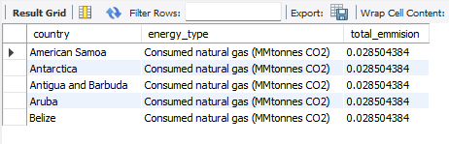
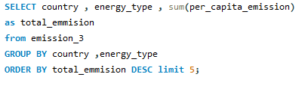
Global Energy Comparison Output
Emission Contribution By Energy Type Output

Slide 10
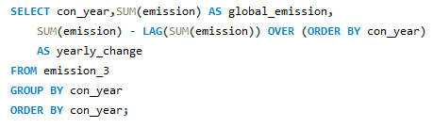
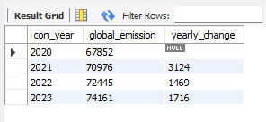
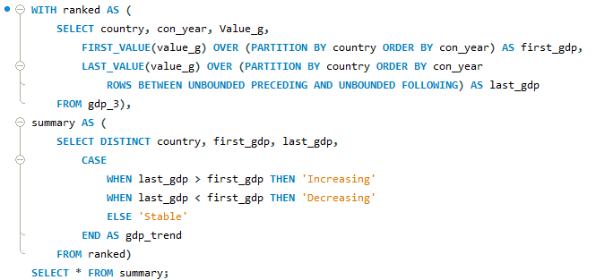
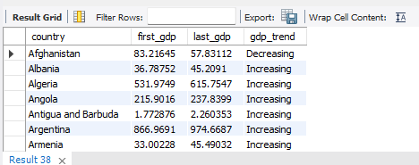
Year-wise Change in Global Emissions Output
GDP Trend Analysis by Country Output

Slide 11
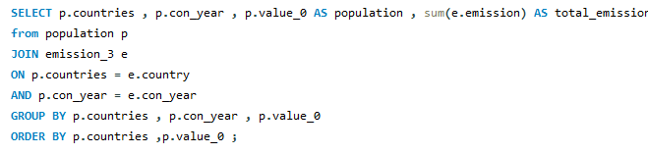
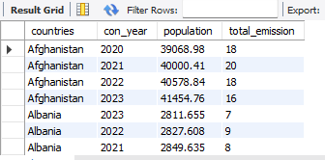
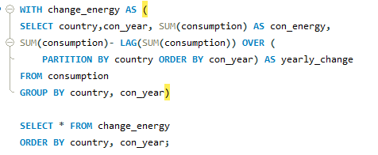
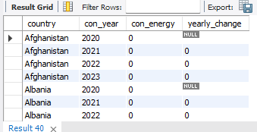
Impact of Population Growth on Emissions Output
Energy Consumption Trends in Major Economies Output

Slide 12
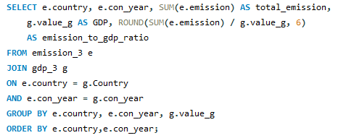
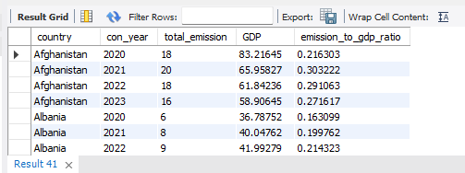
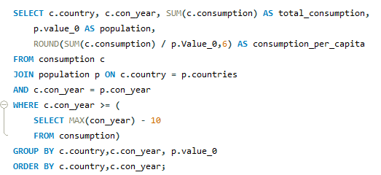
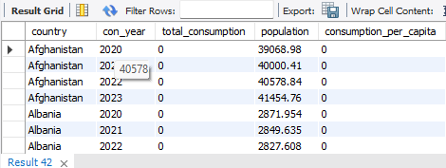
Emission-to-GDP Ratio by Country and Year Output
Energy Consumption Per Capita Over the Last Decade Output

Slide 13
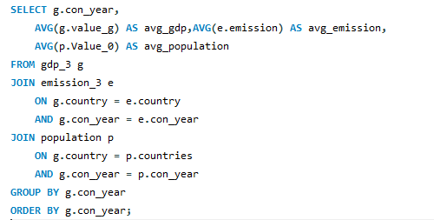
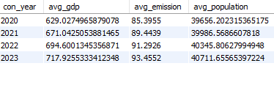
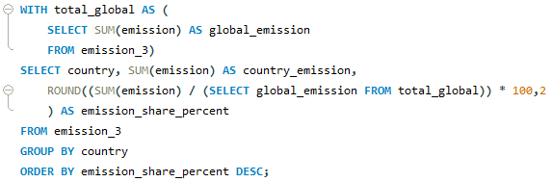
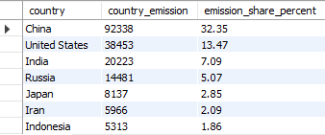
Global Economic & Environmental Indicators by Year Output
Percentage Share of Emissions by Nation Output

Slide 14
CONCLUSION
06
The integrated analysis of GDP, energy consumption, carbon emissions, and population reveals strong interdependencies between economic growth and environmental impact. The study shows that many high-growth economies still rely heavily on energy-intensive and carbon-emitting activities. At the same time, it highlights variations across countries, indicating that some nations are progressing toward more efficient and sustainable growth models. Overall, the unified framework successfully eliminates data silos and provides a comprehensive view of global sustainability challenges.

Slide 15
RECOMMENDATIONS
06
Countries should focus on decoupling economic growth from carbon emissions by adopting cleaner technologies and renewable energy sources.
Investment in energy efficiency improvements across industries can significantly reduce environmental impact without slowing GDP growth.
Policymakers should encourage sustainable urban planning and green infrastructure to manage population-driven energy demand.
High-emission countries should implement stricter environmental regulations and carbon reduction targets.
Continuous monitoring through integrated dashboards (like Power BI models) should be used to support data-driven climate policy decisions.

Slide 16


THANK YOU

Slide 17
THANK YOU

